Slide 1
Church Attendance Analysis
Richard M. Ostberg Ph.D.

Slide 2
Background
Data Science Practicum
Project suggested by Christy Pearson
Goal: Draw insights into current and future church attendance based on historical data
Research questions:
Did moving to one service for a time impact current attendance?
Has growth kept up with growth in the surrounding area?
Is there a point where growth will require a larger space?
Do other factors impact church attendance?

Slide 3
Data Overview
Church Attendance data provided by Christy
First, Second Service
Christmas Services
Wednesday services and religious observances
Snow events and cancellations
Additional data gathered
Snow and precipitation
School status (school in or out)
Total attendance and average attendance most useful
Sunday services (highest attendance) used for analysis

Slide 4
Research Q: Did single service over the Summer impact fall attendance?
No significant differences found from pre-single or single-post
Tested with and without Easter and Christmas Sunday, 2016
However…

Slide 5
Research Q: Did single service over the weekend impact fall attendance?
Comparing Attendance before and after the single service period does show a statistically significant increase
Increase from 138 to 155 total attendance on Sundays
Partially explained by growth of attendance overall

Slide 6
Research Q: Did single service over the weekend impact fall attendance?
Another look showing attendance distribution

Slide 7
Research Q: Did single service over the weekend impact fall attendance?
Comparing Attendance in 2019-2020 shows attendance is the same before and after
Average total attendance on Sundays 154.5 vs 155
Mean attendance during single service was 126

Slide 8
Research Q: Did single service over the weekend impact fall attendance in 2019-20?
Another look showing attendance distribution

Slide 9
Corollary: Was Wednesday attendance Affected?
Average Wednesday attendance is up from 65 to 77 on average, but is not statistically significant.
Partially explained by growth.

Slide 10
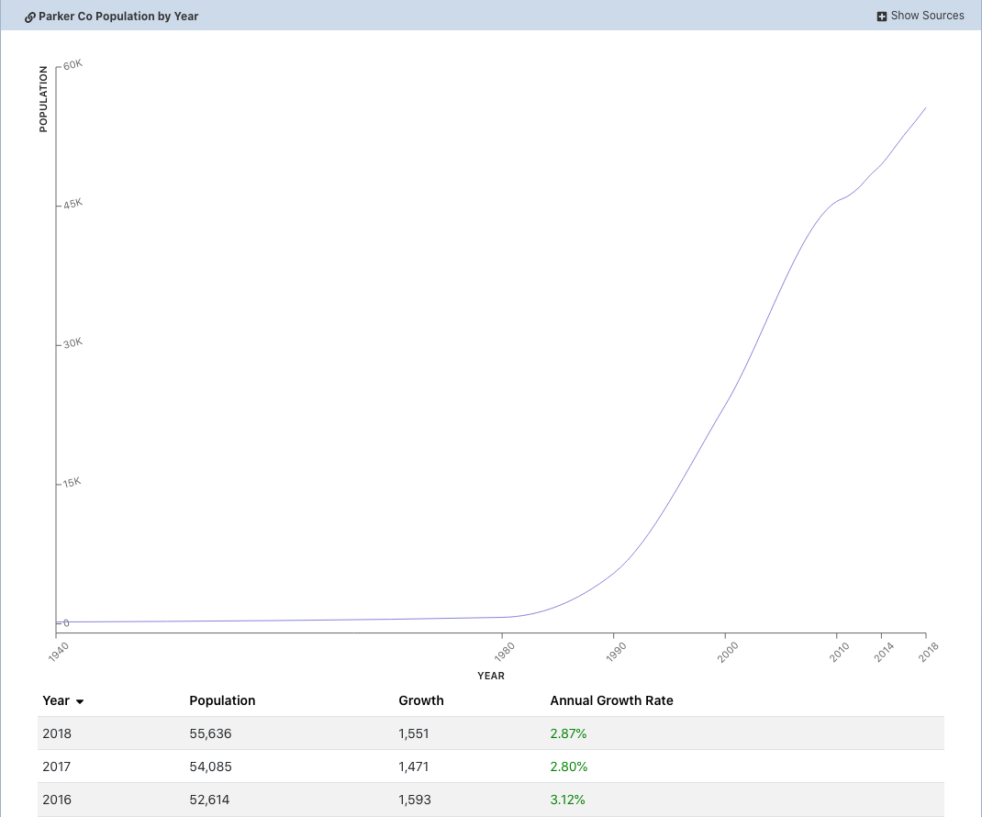
Research Question: Has Church Growth Kept up with Parker Growth?
http://worldpopulationreview.com/us-cities/parker-co-population/

Slide 11
First Look: Linear Growth
Year over year weekly figures show Median growth rate of 5.9%
and average growth of 10.6%, well exceeding Parker population growth

Slide 12
Seasonal Model (With Forecast)
Seasonal modeling shows similar growth,
with spikes for major religious holidays (Christmas/Easter).
Continued growth is projected for the future.

Slide 13
Space considerations (Average Service Size)
Average Service size is growing, however a linear model is influenced
by the recent ‘Single Service’ experience. Replacement with representative
data may be more informative.

Slide 14
Space considerations (Average Service Size)
Replacing with representative data (based on historical patterns)
shows growth in average attendance.

Slide 15
Space considerations (Average Service Size)
Seasonal model shows same growth pattern,
dark grey 80% confidence, light grey 95% confidence.
Next year average ~128/service, peak ~150.
Peak could reach 175 by 2023

Slide 16
Do other Factors (pastors, school, snow) Affect attendance?
Multiple Regression model analyzed:
Secular holidays
Religious holidays
Alternate pastors
Church events such as member meetings or socials
Weather events, snow and precipitation
Local schools in or out of session
Summary: Religious holidays (Christmas/Easter) significantly affect attendance.

Slide 17
Do other Factors (pastors, school, snow) Affect attendance?
Second Multiple Regression model analyzed data excluding religious holidays:
Secular holidays
Alternate pastors
Church events such as member meetings or socials
Weather events, snow and precipitation
Local schools in or out of session
Summary: Alternate pastors tend to draw smaller attendance, ~21 fewer.
New snow tends to reduce attendance, -14 per inch of new snow.
However, if there is existing snow, this mitigates the impact, +5 per inch of existing snow..

Slide 18
Summary of findings
Moving to single service did not impact continued attendance
Congregation growth is 5-10% per year, more than population growth
Growth is projected to continue, peak attendance could reach 175/service in 3 years
External factors and one-time events do not statistically impact attendance.

Slide 19
Questions?
Richard M. Ostberg Ph.D.
Sage Advice LLC
303-547-7015

Slide 20
Appendix

Slide 21
Coefficients For Multiple Regression
Estimate Std. Error t value Pr(>|t|)
(Intercept) 134.234 4.983 26.937 <2e-16 ***
Secular.Holiday -9.815 11.952 -0.821 0.4139
Religious.Holiday 31.868 12.649 2.519 0.0137 *
Alternate.Pastor -21.061 12.110 -1.739 0.0858 .
Church.Event 9.081 12.977 0.700 0.4860
Weather.Event -24.381 23.322 -1.045 0.2989
Precipitation -8.822 24.929 -0.354 0.7243
Snow -8.016 6.263 -1.280 0.2042
SnowDepth 4.432 2.850 1.555 0.1238
DougCtySchoolOut -5.741 7.232 -0.794 0.4296
---
Signif. codes: 0 ‘***’ 0.001 ‘**’ 0.01 ‘*’ 0.05 ‘.’ 0.1 ‘ ’ 1
Residual standard error: 31.61 on 82 degrees of freedom
(101 observations deleted due to missingness)
Multiple R-squared: 0.1822, Adjusted R-squared: 0.09239
F-statistic: 2.029 on 9 and 82 DF, p-value: 0.04607

Slide 22
Coefficients For Multiple Regression, No holidays
Estimate Std. Error t value Pr(>|t|)
(Intercept) 135.412 3.177 42.623 < 2e-16 ***
Secular.Holiday -8.778 7.913 -1.109 0.270770
Religious.Holiday NA NA NA NA
Alternate.Pastor -21.554 7.561 -2.851 0.005616 **
Church.Event 9.731 8.101 1.201 0.233398
Weather.Event -20.124 14.568 -1.381 0.171190
Precipitation -4.504 15.575 -0.289 0.773209
Snow -14.498 3.982 -3.641 0.000493 ***
SnowDepth 5.398 1.785 3.024 0.003401 **
DougCtySchoolOut -7.954 4.706 -1.690 0.095094 .
---
Signif. codes: 0 ‘***’ 0.001 ‘**’ 0.01 ‘*’ 0.05 ‘.’ 0.1 ‘ ’ 1
Residual standard error: 19.73 on 76 degrees of freedom
(96 observations deleted due to missingness)
Multiple R-squared: 0.3406, Adjusted R-squared: 0.2712
F-statistic: 4.906 on 8 and 76 DF, p-value: 6.588e-05

